Slide 1


Unit – 3 Methods and Arrays
Prepared By
Prof. Ravikumar Natarajan
Assistant Professor, CE Dept.

Slide 2
Method in Java
A Java method is a collection of statements that are grouped together to perform an operation. When you call the System.out.println() method, for example, the system actually executes several statements in order to display a message on the console.
Now we will learn how to create your own methods with or without return values, invoke a method with or without parameters, and apply method abstraction in the program design.

Slide 3
Creating method
Considering the following example to explain the syntax of a method −
Syntax:
modifier returnType nameOfMethod (Parameter List) {
// method body
}

Slide 4

Methods in Java
The syntax shown above includes −
modifier − It defines the access type of the method and it is optional to use.
returnType − Method may return a value.
nameOfMethod − This is the method name. The method signature consists of the method name and the parameter list.
Parameter List − The list of parameters, it is the type, order, and number of parameters of a method. These are optional, method may contain zero parameters.
method body − The method body defines what the method does with the statements.

Slide 5
Example
public static int minFunction(int n1, int n2) {
int min;
if (n1 > n2)
min = n2;
else
min = n1;
return min;
}

Slide 6
Method Calling
For using a method, it should be called. There are two ways in which a method is called i.e., method returns a value or returning nothing (no return value).
The process of method calling is simple. When a program invokes a method, the program control gets transferred to the called method. This called method then returns control to the caller in two conditions, when −
the return statement is executed.
it reaches the method ending closing brace.
The methods returning void is considered as call to a statement. Lets consider an example − System.out.println("This is method!");
The method returning value can be understood by the following example − int result = sum(6, 9);

Slide 7
Examples
Check Programs → FunctionWithReturn.java ,
FunctionWithoutReturn.java

Slide 8
FunctionWithReturn
//A method with a return value
public class Main {
static int myMethod(int x) {
return 5 + x;
}
public static void main(String[] args) {
System.out.println(myMethod(3));
}
}
public class ReturnTypeTest1 {
public int add() { // without arguments
int x = 30; int y = 70; int z = x+y;
return z;
}
public static void main(String args[]) {
ReturnTypeTest1 test = new ReturnTypeTest1();
int add = test.add();
System.out.println("The sum of x and y is: " + add);
}
}
public class ReturnTypeTest2 {
public int add(int x, int y) { // with arguments
int z = x+y;
return z;
}
public static void main(String args[]) {
ReturnTypeTest2 test = new ReturnTypeTest2();
int add = test.add(10, 20);
System.out.println("The sum of x and y is: " + add);
}
}

Slide 9
FunctionWithoutReturn
// Java Program to Illustrate a Method
// with 2 Parameters and without Return Type
import java.util.*;
public class Main {
public static void main(String args[])
{
int a = 4;
int b = 5;
// Calling the function with 2 parameters
calc(a, b);
}
public static void calc(int x, int y)
{
int sum = x + y;
// Displaying the sum
System.out.print("Sum of two numbers is :" + sum);
}
}
//A method without any return values:
public class Main {
static void myMethod() {
System.out.println("I just got executed!");
}
public static void main(String[] args) {
myMethod();
}
}

Slide 10
Parameter Passing in Java
There are different ways in which parameter data can be passed into and out of methods and functions. Let us assume that a function B() is called from another function A(). In this case A is called the “caller function” and B is called the “called function or callee function”. Also, the arguments which A sends to B are called actual arguments and the parameters of B are called formal arguments.
Types of parameters:
Formal Parameter : A variable and its type as they appear in the prototype of the function or method.
Syntax:
function_name(datatype variable_name)
Actual Parameter : The variable or expression corresponding to a formal parameter that appears in the function or method call in the calling environment.
Syntax:
func_name(variable name(s));

Slide 11
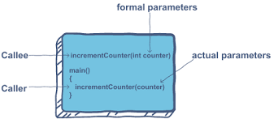

Slide 12
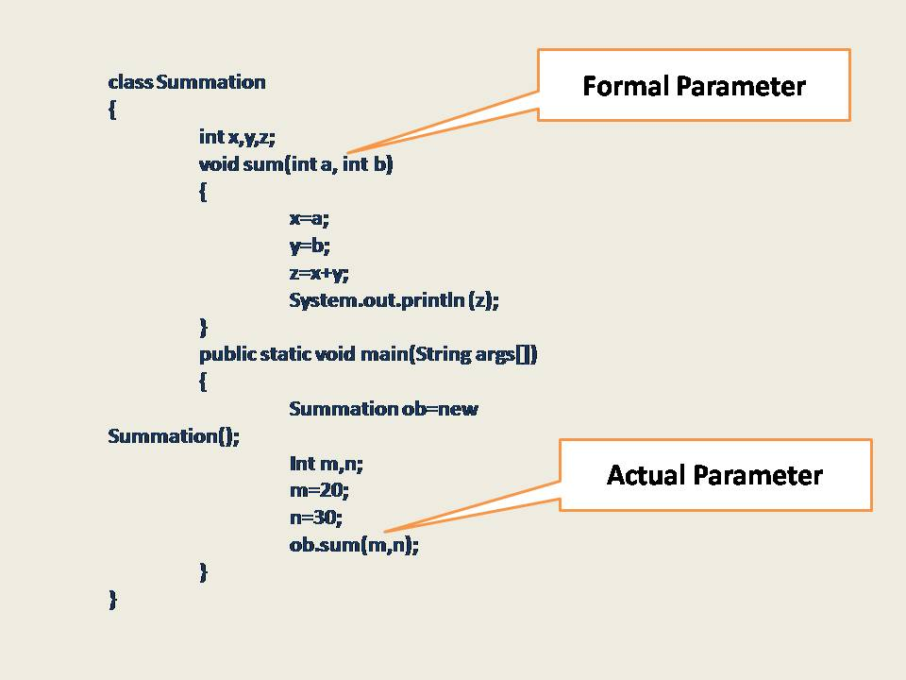

Slide 13
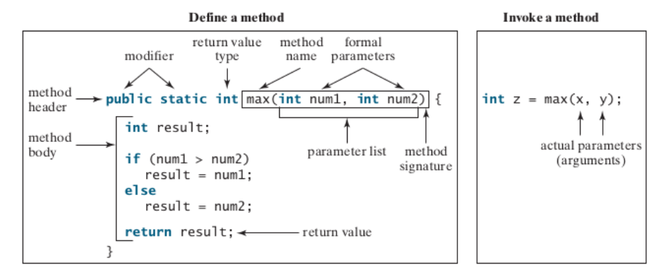
Define and Invoke Method in Java

Slide 14
Parameter Passing in Java
parameter passing in Java is always Pass-by-Value. However, the context changes depending upon whether we're dealing with Primitives or Objects:
For Primitive types, parameters are pass-by-value
For Object types, the object reference is pass-by-value
In case of primitives, the value is simply copied inside stack memory which is then passed to the callee method.
In case of non-primitives, a reference in stack memory points to the actual data which resides in the heap. When we pass an object, the reference in stack memory is copied and the new reference is passed to the method.
Check Example : Unit 3 → CallByValue.java , CallByReference.java

Slide 15
Pass By Value / Call by Value
“Call by value” in Java means that argument’s value is copied and is passed to the parameter list of a method.
That is, when we call a method with passing argument values to the parameter list, these argument values are copied into the small portion of memory and a copy of each value is passed to the parameters of the called method.
When these values are used inside the method either for “read or write operations”, we are actually using the copy of these values, not the original argument values which are unaffected by the operation inside the method.
That is, the values of the parameters can be modified only inside the scope of the method but such modification inside the method doesn’t affect the original passing argument.
When the method returns, the parameters are gone and any changes to them are lost. This whole mechanism is called call by value or pass by value.
Check Example : Unit 3 → CallByValue.java

Slide 16
//CallByValue
public class Main
{
int change(int b)
{
++b; // Changes will be in the local variable only.
return b;
}
public static void main(String[] args)
{
// Create an object of class.
Main obj = new Main();
int a = 20;
int x = obj.change(a);
System.out.println("Value of a after passing: " +a);
System.out.println("Value of x after modifying: " +x);
}
}

Slide 17
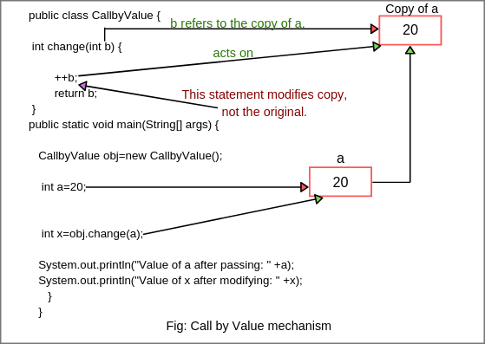

Slide 18
Call by reference(aliasing)
Call by Reference means calling a method with a parameter as a reference. Through this, the argument reference is passed to the parameter.
In call by value, the modification done to the parameter passed does not reflect in the caller's scope while in the call by reference, the modification done to the parameter passed are persistent and changes are reflected in the caller's scope.
Check Example : Unit 3 → CallByReference.java

Slide 19
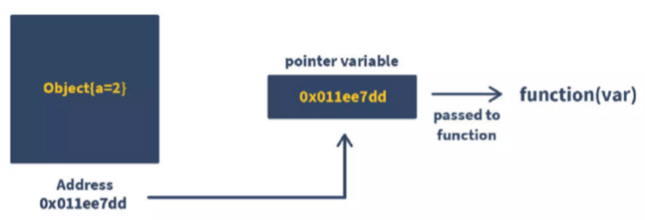
Call by reference(aliasing)

Slide 20
Call By Value vs Call By Reference
public class Main{
//call-by-value
int a = 10;
void call(int a) {
a = a+10;
}
public static void main(String[] args) {
Main eg = new Main();
S.o.p("Before call-by-value: " + eg.a);
eg.call(50510);
S.o.p("After call-by-value: " + eg.a);
}
}
public class Main{
int a = 10;
void call(Main e) {
e.a = e.a+10;
}
public static void main(String[] args) {
Main e = new Main();
S.o.p("Before call-by-reference: " + e.a);
e.call(e);
S.o.p("After call-by-reference: " + e.a);
}
}

Slide 21
Overloading methods
In Java, two or more methods can have same name if they differ in parameters (different number of parameters, different types of parameters, or both). These methods are called overloaded methods and this feature is called method overloading. For example:
void func() { ... }
void func(int a { ... }
float func(double a) { ... } float func(int a, float b) { ... }
Here, the func() method is overloaded. These methods have the same name but accept different arguments.
Notice that, the return type of these methods is not the same. Overloaded methods may or may not have different return types, but they must differ in parameters they accept.

Slide 22
Why method overloading ?
Suppose, you have to perform the addition of given numbers but there can be any number of arguments (let’s say either 2 or 3 arguments for simplicity).
In order to accomplish the task, you can create two methods : sum2num(int, int) and
sum3num(int, int, int) for two and three parameters respectively.
However, other programmers, as well as you in the future may get confused as the behavior of both methods are the same but they differ by name.
The better way to accomplish this task is by overloading methods. And, depending upon the argument passed, one of the overloaded methods is called. This helps to increase the readability of the program.

Slide 23

Method overloading
Two or more methods can have same name inside the same class if they accept different arguments. This feature is known as method overloading.
Method overloading is achieved by either:
changing the number of arguments.
(Check Program: Unit – 3 → MethodOverloading1.java)
changing the datatype of arguments.
(Check Program: Unit – 3 → MethodOverloading2.java)
Method overloading is not possible by changing the return type of methods.

Slide 24
Method overloading
//changing the data type of parameters
class MethodOverloading2 {
// this method accepts int
private static void display(int a){
System.out.println("Got Integer data.");
}
// this method accepts String object
private static void display(String a){
System.out.println("Got String object.");
}
public static void main(String[] args) {
display(1);
display("Hello");
}
}
//Overloading by changing the number of parameters
class MethodOverloading {
private static void display(int a){
System.out.println("Arguments: " + a);
}
private static void display(int a, int b){
System.out.println("Arguments: " + a + " and " + b);
}
public static void main(String[] args) {
display(1);
display(1, 4);
}
}

Slide 25

Can we overload java main() method?
Yes, by method overloading. You can have any number of main methods in a class by method overloading. But JVM calls main() method which receives string array as arguments only. Let's see the simple example:
class TestOverloading4{
public static void main(String[] args)
{System.out.println("main with String[]");}
public static void main(String args)
{System.out.println("main with String");}
public static void main()
{System.out.println("main without args");}
}
Output:
main with String[]

Slide 26
Method Overloading
Why Method Overloading is not possible by changing the return type of method only?
In java, method overloading is not possible by changing the return type of the method only because of ambiguity. Let's see how ambiguity may occur:
class Adder{
static int add(int a,int b){return a+b;}
static double add(int a,int b){return a+b;}
}
class TestOverloading3{
public static void main(String[] args){ System.out.println(Adder.add(11,11));//ambiguity
}}
OUTPUT :
Compile Time Error: method add(int,int) is already defined in class Adder

Slide 27
Scope of Variables
The scope of a variable is the part of the program where the variable can be referenced.
A variable defined inside a method is referred to as a local variable. The scope of a local variable starts from its declaration and continues to the end of the block that contains the variable.
public class Main{
public static void main(String[] args) {
for(int i=0; i<10; i++){
System.out.println(i); }
System.out.println(i); //Out of scope
}}

Slide 28
Method Abstraction and Stepwise Refinement
Method abstraction is achieved by separating the use of a method from its implementation. The client can use a method without knowing how it is implemented.
The details of the implementation are encapsulated in the method and hidden from the client who invokes the method. This is also known as information hiding or encapsulation.
Ex. Println(), max() all in-built methods ,you only know how to invoke this method, but you are not required to know how they are implemented.
Method abstraction can be applied to the process of developing programs.
When writing a large program, you can use the divide-and-conquer strategy, also known as stepwise refinement, to decompose it into sub-problems. The sub-problems can be further decomposed into smaller, more manageable problems.

Slide 29
Method Abstraction and Stepwise Refinement
Top-Down Design:
Problem is broken into sub-problems.
For Ex. To calculate area of circle, first read the input, then implement the actual logic and then print the answer.
Top-Down Vs Bottom-up Implementation:
Top down approach begins with high level design and ends with low level design or development. Whereas, bottom up approach begins with low level design or development and ends with high level design.
In top down approach, main() function is written first and all sub functions are called from main function. Then, sub functions are written based on the requirement. Whereas, in bottom up approach, code is developed for modules and then these modules are integrated with main() function.

Slide 30
Method Abstraction and Stepwise Refinement
OOPs programming language is Top-Down or Bottom-Up?
OOPs follow Bottom-Up approach

Slide 31
Benefits of stepwise refinement
Each sub-problem can be implemented using a method. This approach makes the program easier to write, reuse, debug, test, modify, and maintain.
Simpler program:
Reusing Methods:
Easier Developing, Debugging and Testing:
Better facilitating teamwork:

Slide 32
Single Dimensional Array
A single array variable can reference a large collection of data.
Once an array is created, its size is fixed. An array reference variable is used to access the elements in an array using an index.
Instead of declaring individual variables, such as number0, number1, . . . , and number99, you declare one array variable such as numbers and use numbers[0], numbers[1], . . . , and numbers[99] to represent individual variables.

Slide 33
Declaring 1-D Array Variables
Syntax:
datatype[ ] arr_ref_var;
OR
datatype arr_ref_var[ ];
Ex. double myList[ ];
Unlike declarations for primitive data type variables, the declaration of an array variable does not allocate any space in memory for the array. It creates only a storage location for the reference to an array.
you can create an array by using the new operator and assign its reference to the variable.
Syntax:
Arr_ref_var = new datatype [ size ];

Slide 34
Declaring 1-D Array Variables
Declaring an array variable, creating an array, and assigning the reference of the array to the variable can be combined in one statement as:
datatype[ ] arr_ref_var = new datatype [ Size ];
OR
datatype arr_ref_var[ ] = new datatype [ Size ];
Ex. double[] myList = new double[10];

Slide 35
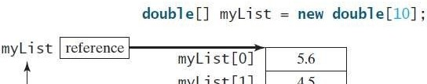
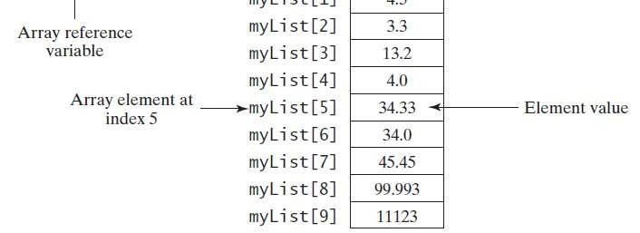
Assign values to Array
Ex.
myList[0] = 5.6;
myList[1] = 4.5;
myList[2] = 3.3;
myList[3] = 13.2;
myList[4] = 4.0;
myList[5] = 34.33;
myList[6] = 34.0;
myList[7] = 45.45;
myList[8] = 99.993;
myList[9] = 11123;

Slide 36
Array size and default values
The size of an array cannot be changed after the array is created.
Size can be obtained using arr_ref_var.length.
For example, myList.length is 10.
myList holds 10 double values, and the indices are from 0 to 9.
For example, myList[9] represents the last element in the array myList.
Array Initializer:
Syntax: elementType[] arrayRefVar = {value0, value1, ..., valuek}; Example: double[] myList = {1.9, 2.9, 3.4, 3.5};

Slide 37
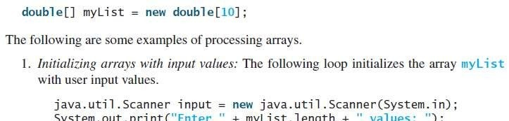
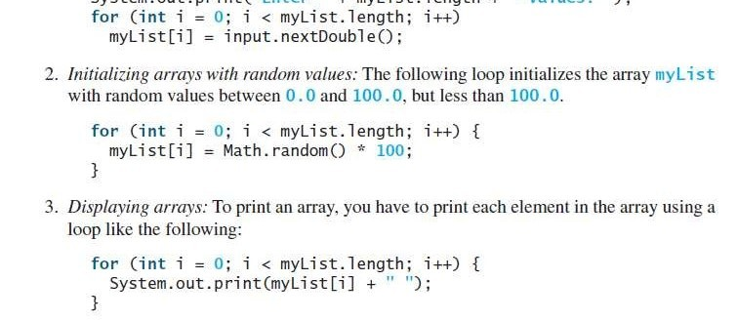
Processing Array

Slide 38
1D – Array Example
public class Array1D{
public static void main(String args[])
{
double[ ] mylist = new double[10]; // Array declaration
java.util.Scanner sc = new java.util.Scanner(System.in);
System.out.println("Enter " + mylist.length + " values ");
//intialization array with input values
for(int i=0;i<mylist.length;i++)
mylist[i] = sc.nextInt();
//Display Array
for(int i=0;i<mylist.length;i++)
System.out.print((int)mylist[i] + " ");
}
}

Slide 39
For each Loop
For Java supports a convenient for loop, known as a foreach loop, which enables you to traverse the array sequentially without using an index variable.
Syntax:
for (elementType element: arrayRefVar)
{
// Process the element
}
You can read the code as “for each element e in myList, do the following.” If you wish to traverse in different order then you need index variable.
Ex.
for(double e : myList)
{
System.out.println(e);
}

Slide 40
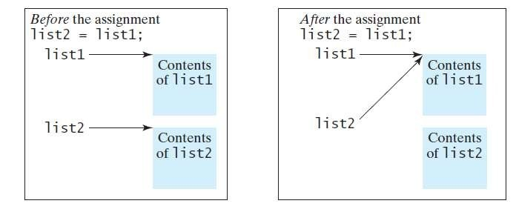
Copying Array
To copy the contents of one array into another, you have to copy the array’s individual elements into the other array.
Method : 1
list2 = list1;
This statement does not copy the contents of the array referenced by list1 to list2, but instead it copies the reference value from list1 to list2.

Slide 41
Copying Array
The other 3 ways to copy Array:
Method 2: Use a loop to copy individual elements one by one.
Method 3: Use the static arraycopy method in the System class.
Method 4: Use the clone method to copy arrays
Method 2: Loop to copy individual element
int[] sourceArray = {2, 3, 1, 5, 10};
int[] targetArray = new int[sourceArray . length];
for (int i = 0; i < sourceArray.length; i++)
{
targetArray[i] = sourceArray[i];
}

Slide 42
Copying Array – Method 1
class Main {
public static void main(String[] args) {
int [] numbers = {1, 2, 3, 4, 5, 6};
int [] positiveNumbers = numbers; // copying arrays
// change value of first array
numbers[0] = -1;
// printing the second array
for (int number: positiveNumbers) {
System.out.print(number + ", ");
}
}
}

Slide 43
Copying Array – Method 2
import java.util.Arrays;
class Main {
public static void main(String[] args) {
int [] source = {1, 2, 3, 4, 5, 6};
int [] destination = new int[6];
// iterate and copy elements from source to destination
for (int i = 0; i < source.length; ++i) {
destination[i] = source[i];
}
// converting array to string
System.out.println(Arrays.toString(destination));
}
}

Slide 44
Copying Array – Method 3
//arraycopy
import java.util.Arrays;
class Main {
public static void main(String[] args) {
int[] n1 = {2, 3, 12, 4, 12, -2};
// Creating n2 array of having length of n1 array
int[] n2 = new int[n1.length];
// copying entire n1 array to n2
System.arraycopy(n1, 0, n2, 0, n1.length);
System.out.println("n2 = " + Arrays.toString(n2));
}
}

Slide 45
Copying Array
Method 3: Another approach is to use the arraycopy method in the
java.lang.System class to copy arrays instead of using a loop.
Syntax: arraycopy(sourceArray, srcPos, targetArray, tarPos, length);
Ex: System.arraycopy(sourceArray, 0, targetArray, 0, sourceArray.length);
Method 4: Another approach is to use the clone method in the

Slide 46
Copying Array – Method 4
class Main {
public static void main(String args[]) {
int num_Array[] = {5,10,15,20,25,30};
int clone_Array[] = num_Array.clone();
System.out.println("Original num_Array:");
for (int i = 0; i <num_Array.length; i++) {
System.out.print(num_Array[i]+" ");
}
System.out.println();
System.out.println("Cloned num_Array:");
for (int i = 0; i <clone_Array.length; i++) {
System.out.print(clone_Array[i]+" ");
}
}
}

Slide 47
Two-Dimensional Array
Data in a table or a matrix can be represented using a two- dimensional array.
An element in a two-dimensional array is accessed through a row and column index.
Syntax:
elementType[ ][ ] arrayRefVar;
OR
elementType arrayRefVar[ ][ ];
Ex:
int[ ][ ] matrix;
OR
int matrix[ ][ ];

Slide 48
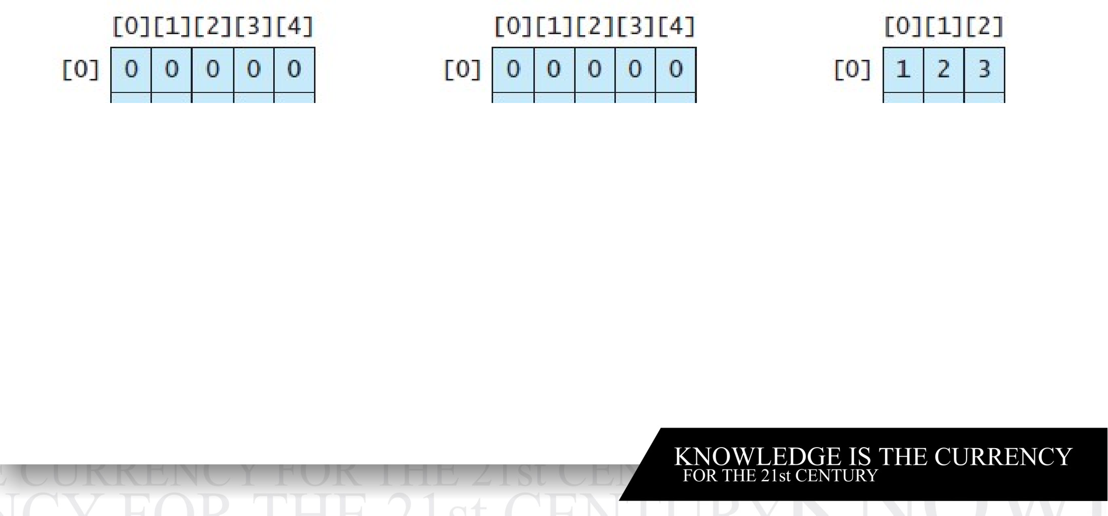
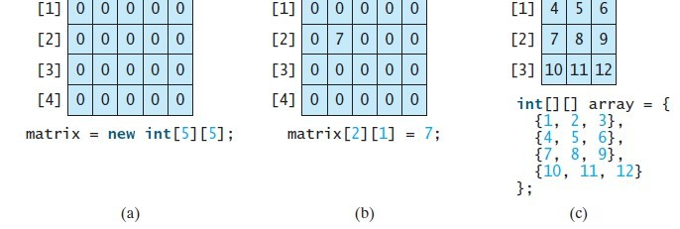
Two-Dimensional Array
matrix = new int[5][5];

Slide 49
Two-Dimensional Array
class Main
{
public static void main(String args[])
{
int[][] a={{10,20},{30,40}};//declaration and initialization
System.out.println("Two dimensional array elements are");
System.out.println(a[0][0]);
System.out.println(a[0][1]);
System.out.println(a[1][0]);
System.out.println(a[1][1]);
}
}

Slide 50
Two-Dimensional Array

Slide 51
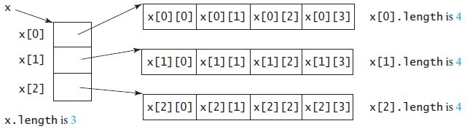
Obtaining length of 2-D Array
Example:
x = new int[3][4], x[0], x[1], and x[2] are one-dimensional arrays and each contains four elements. So, x.length is 3, and x[0].length, x[1].length, and x[2].length are 4.

Slide 52
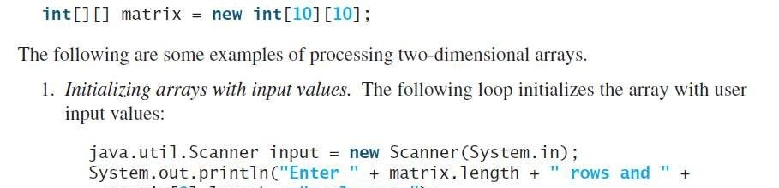
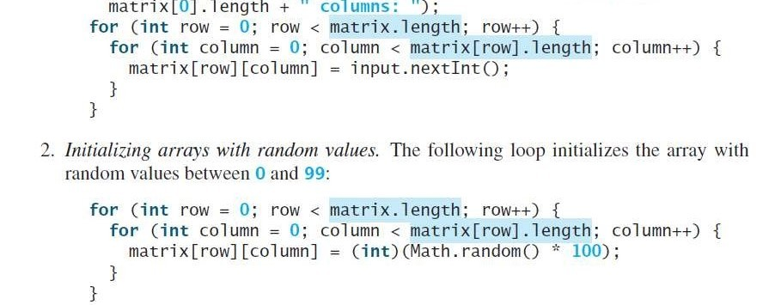
Processing 2-D Arrays

Slide 53
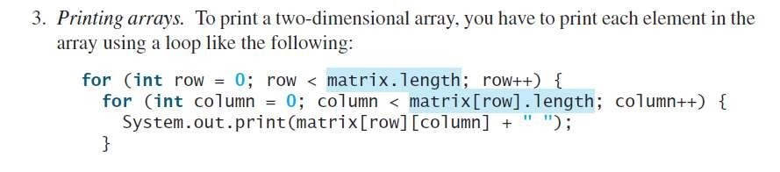

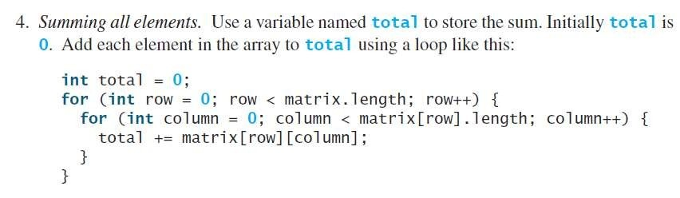
Processing 2-D Arrays

Slide 54
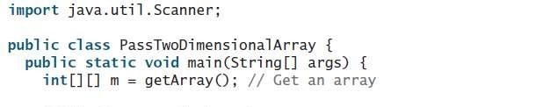
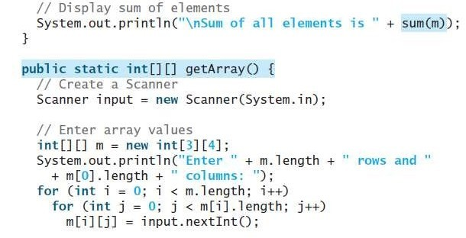
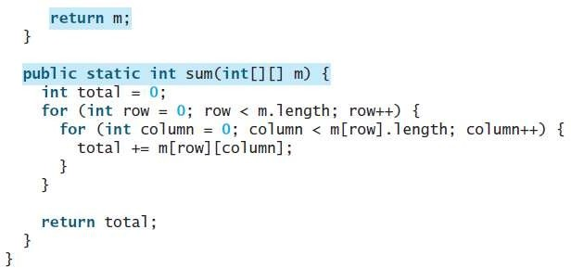
Passing 2-D Array to methods
When passing a two-dimensional array to a method, the reference of the array is passed to the method.

Slide 55
2-D Array Example
class Main
{
public static void main(String args[])
{
int[][] a={{10,20},{30,40},{50,60}};//declaration and initialization
System.out.println("Two dimensional array elements are");
for (int i = 0; i < 3; i++)
{
for (int j = 0; j < 2; j++)
{
System.out.println(a[i][j]);
}
}
}
}

Slide 56
2-D Array to Method Example
public class Main {
public static void main(String[] args) {
int[][] a = { { 1, 2, 3 }, { 4, 5, 6 }, { 7, 8, 9 } };
arr2method(a); // pass it to the method
}
public static void arr2method(int[][] a) {
System.out.println("Elements are :");
for (int i = 0; i < a.length; i++) {
for (int j = 0; j < a[i].length; j++) {
System.out.print(a[i][j] + "\t");
}
System.out.println("");
}
}
}

Slide 57
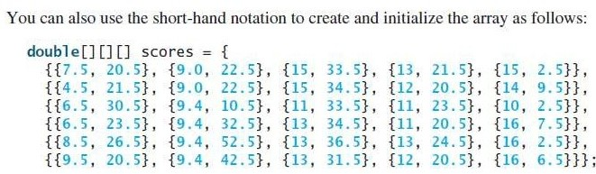
Multi Dimensional Array
A two-dimensional array consists of an array of one-dimensional arrays and a three dimensional array consists of an array of two- dimensional arrays.

Slide 58
Multi Dimensional Array
Data_Type[][][] Name = new int[Tables][Row_Size][Column_Size];
Int [] [] [] sum = new int [2] [3] [4]
Tables: Total number of tables it can accept. 2D Array is always a single table with rows and columns. In contrast, Multi Dimensional array in Java is more than one table with rows and columns.
Row_Size: Number of Row elements. For example, Row_Size = 3, then the 3D array holds 3 rows.
Column_Size: Column elements it can store. Column_Size = 4, then the 3D array holds 4 Columns.

Slide 59
Multi Dimensional Array
public class Main
{
public static void main(String[] args) {
//initialize 3-d array
int[][][] intArray = { { { 1, 2, 3}, { 4, 5, 6 } , { 7, 8, 9 } } };
System.out.println ("3-d array is given below :");
//print the elements of array
for (int i = 0; i < 1; i++)
for (int j = 0; j < 3; j++)
for (int z = 0; z < 3; z++)
System.out.println ("intArray [" + i
+ "][" + j + "][" + z + "] = " + intArray [i][j][z]);
}
}

Slide 60
Multi Dimensional Array
public class Main {
public static void main(String[] args) {
//initialize 3-d array
int[][][] myArray = { { { 1, 2, 3 }, { 4, 5, 6 } }, { { 1, 4, 9 }, { 16, 25, 36 } },
{ { 1, 8, 27 }, { 64, 125, 216 } } };
System.out.println("3x2x3 array is given below:");
//print the 3-d array
for (int i = 0; i < 3; i++) {
for (int j = 0; j < 2; j++) {
for (int k = 0; k < 3; k++) {
System.out.print(myArray[i][j][k] + "\t");
}
System.out.println();
}
System.out.println();
} } }

Slide 61
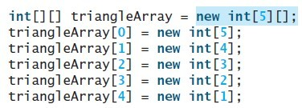
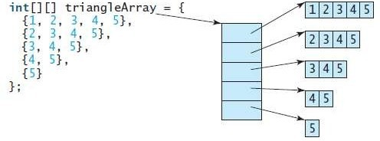

Jagged Array
Each row in a two-dimensional array is itself an array. Thus, the rows can have different lengths. An array of this kind is known as a jagged array.
If you don’t know the values in a jagged array in advance, but do know the sizes.

Slide 62
Jagged Array Example
//Java Program to illustrate the jagged array
class JaggedArrayDemo{
public static void main(String[] args){
//declaring a 2D array with odd columns
int arr[][] = new int[3][];
arr[0] = new int[3];
arr[1] = new int[4];
arr[2] = new int[2];
//initializing a jagged array
int count = 0;
for (int i=0; i<arr.length; i++)
for(int j=0; j<arr[i].length; j++)
arr[i][j] = count++;
//printing the data of a jagged array
for (int i=0; i<arr.length; i++){
for (int j=0; j<arr[i].length; j++){
System.out.print(arr[i][j]+" ");
}
System.out.println();//new line
}
}
}

Slide 63
Jagged Array Example
class Main
{
public static void main(String[] args)
{
// Declare a 2-D array with 3 rows
int myarray[][] = new int[3][];
// define and initialize jagged array
myarray[0] = new int[]{1,2,3};
myarray[1] = new int[]{4,5};
myarray[2] = new int[]{6,7,8,9,10};
// display the jagged array
System.out.println("Two dimensional Jagged Array:");
for (int i=0; i<myarray.length; i++)
{
for (int j=0; j<myarray[i].length; j++)
System.out.print(myarray[i][j] + " ");
System.out.println();
}
}
}

Slide 64
Command-Line Argument
Can a main method receive arguments?
Yes
The main method can receive string arguments from the command line.
Write a program to make calculator using Command Line argument.
class Main{
public static void main(String args[]){
System.out.println("Your first argument is: "+args[0]);
}
}

Slide 65
END OF UNIT - 3

